Slide 1

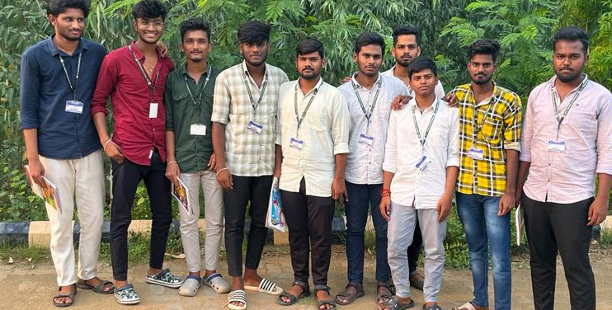
ANNAMACHARYA INSTITUTE OF TECHNOLOGY & SCIENCES
(AUTONOMOUS),TIRUPATI
DEPARTMENT OF CSE
Community Service Project on
Building Digital Skills For Rural Empowerment
By:
G.POORNA CHANDRA(21AK1A05A5)
M.RAJESH NAYAK(21AK1A05A9)
K.NIKHIL(21AK1A05A2)
U.SAI SARAN(21AK1A05C5)
G.LINGA RAJU(21AK1A05B6)
O.SAI CHARAN(21AK1A05C7)
Y.SAI REDDY PUNEETH REDDY(21AK1A05C8)
P.NAVEEN(21AK1A0598)
S.NITHIN REDDI(21AK1A05A3)
K.NITHIN KUMAR REDDY(21AK1A05A4)
Under the Guidance of
Ms.V.S.Gayathri(M.Tech) (Our Guide)
Ms V.S.Gayathri (M.Tech) (Our Coordinator)
Department of Computer Science Engineering (CSE)

Slide 2
TITLE:BUILDING DIGITAL SKILLS FOR RURAL EMPOWERMENT
BATCH NO:9

Slide 3
OBJECTIVE:To Empower the rural communities with digital skills for economic and social development
Presentation Title

Slide 4
INTRODUCTION
Enterpreneurs and talent in web design, data analystics, and other digital skills should be encouraged in rural areas by public policy.Rural innovation clusters, public-private collabrations, and skill development programmes can achieve this.

Slide 5
The major problems we observed are made into a “Root Tree Analysis”
Root tree analysis

Slide 6
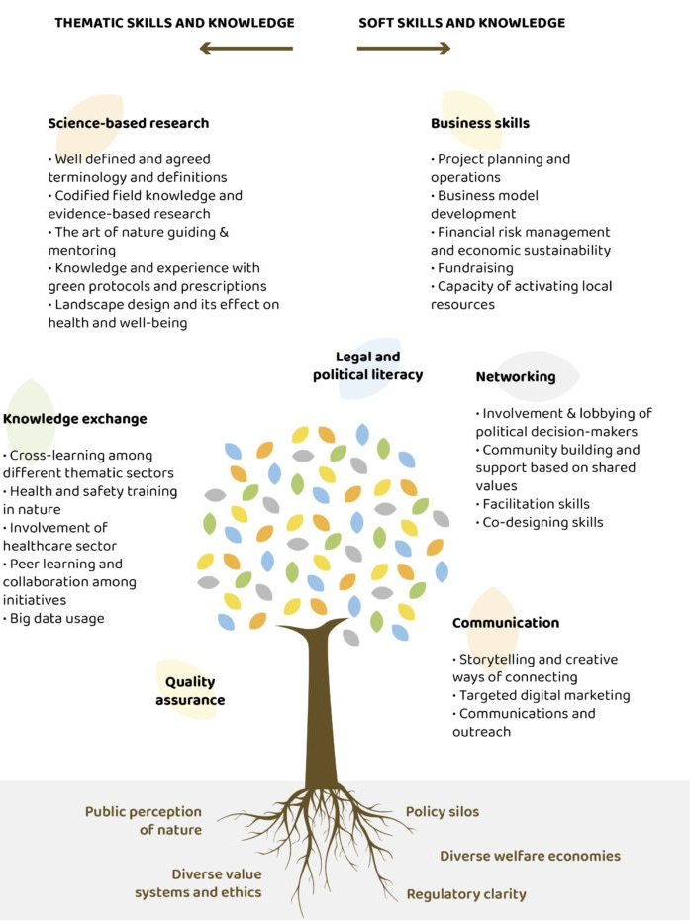

Slide 7
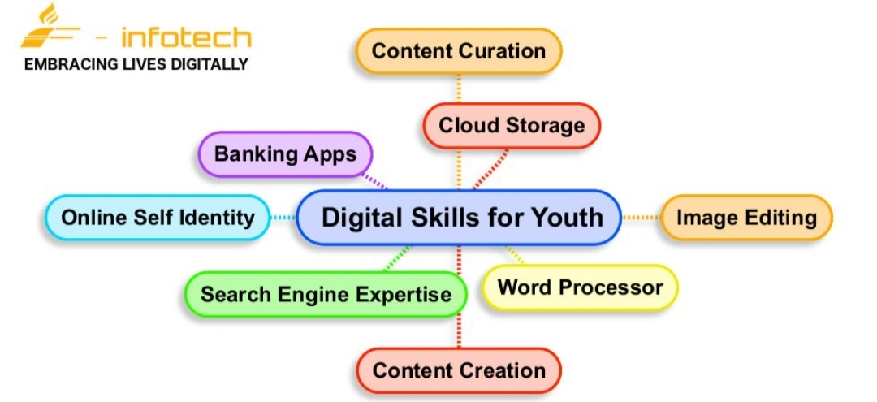

Slide 8
AFTER SURVEYING WE ANALYIZED THE DATA:

Slide 9
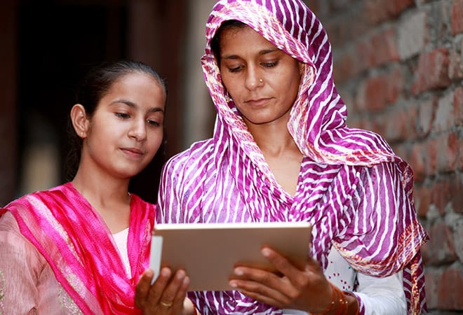
MOBILE PHONES:
A mobile phone can make phone calls, enable the user to send text messages, play games, take pictures, record videos, provide access to the internet, and much more. The mobile phone can be very useful in many different situations. For the past few years the world has witnessed a tremendous growth in mobile phone usage.

Slide 10
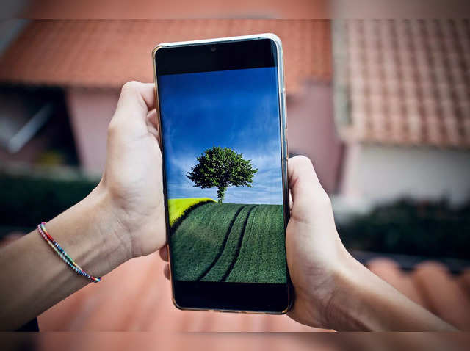
CAUSES:
Software Glitches
Hardware Problems
Network and Connectivity
Storage Issues
Physical Damage
Battery Problems
Security and Malware
Updates and Compatibility

Slide 11
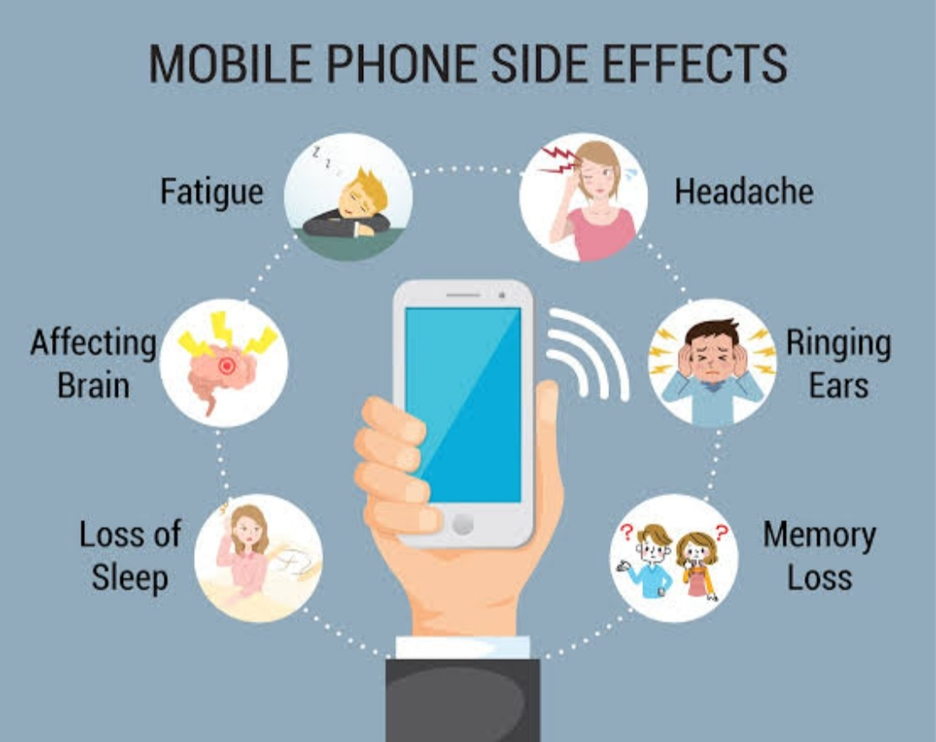
EFFECTS:
FATIGUE
HEADACHE
MEMORY LOSS
LOSS OF SLEEP
AFFECTING BRAIN
RINGING EARS

Slide 12

Advantages of mobile phone usage:
Communication. Mobile phones have eased the communication between people.
Compact Size. One of the biggest advantages of cell phones is their compact size.
Photo and Video Sharing. .
Texting.
Entertainment.
Reminders, Alerts, and Notes.
Travel Purposes.

Slide 13

Instant transfers. Convenient and simple No bank details required during payment Secure transactions.

Slide 14
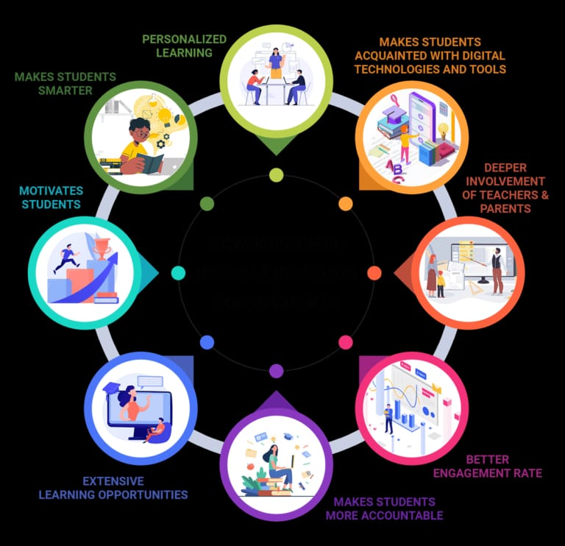

Slide 15
Analysis of Mobile Phones:
ANALYSIS

Slide 16
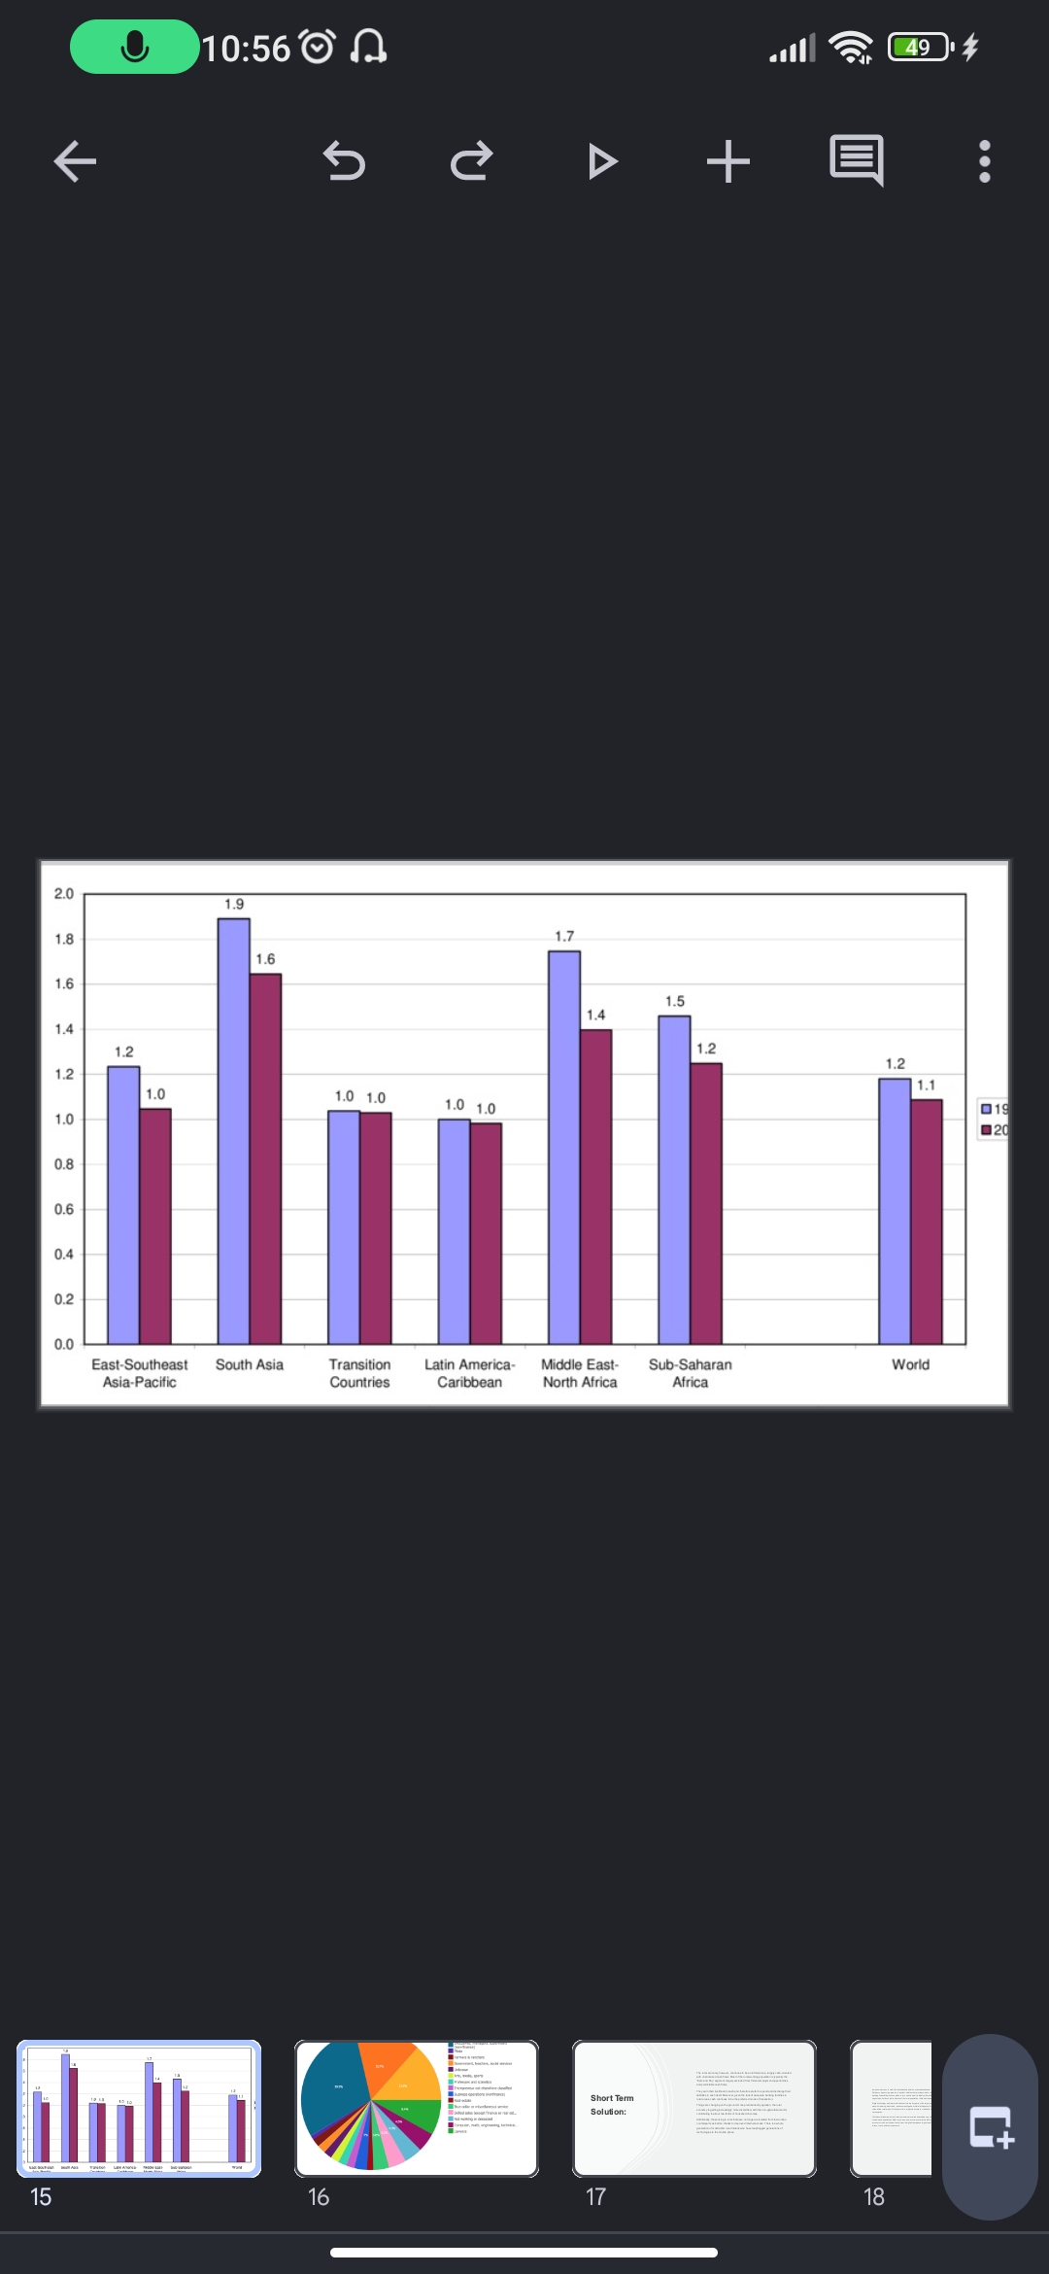
Countries using the mobile phones

Slide 17
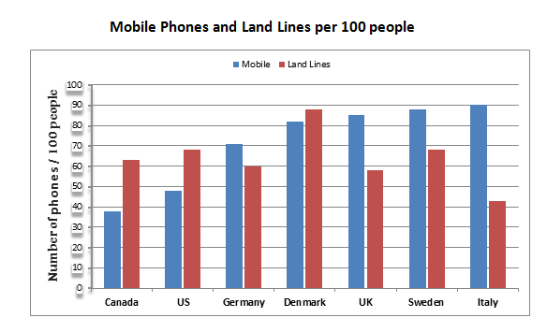

Slide 18
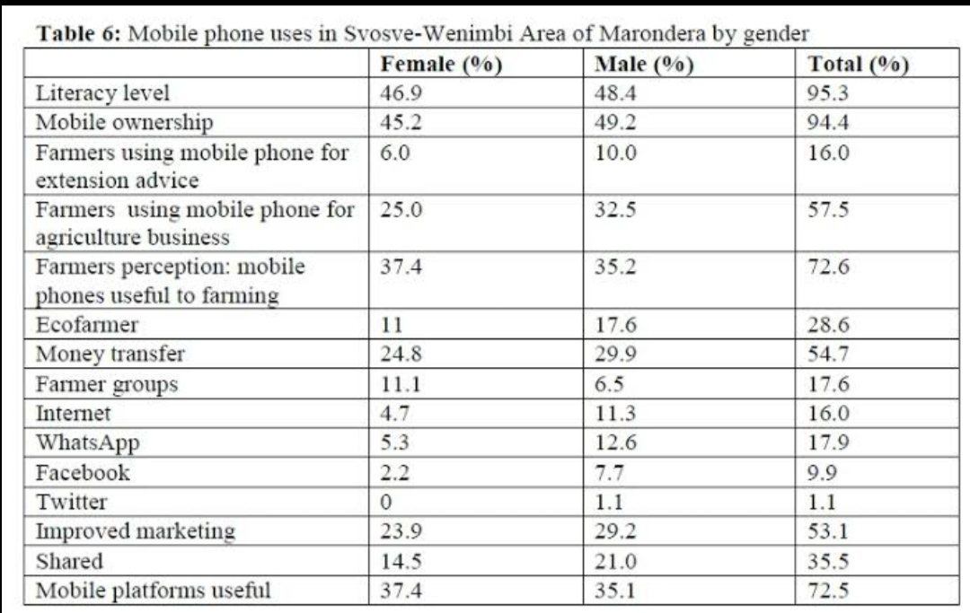
The total number of mobile phones used by both male and female

Slide 19
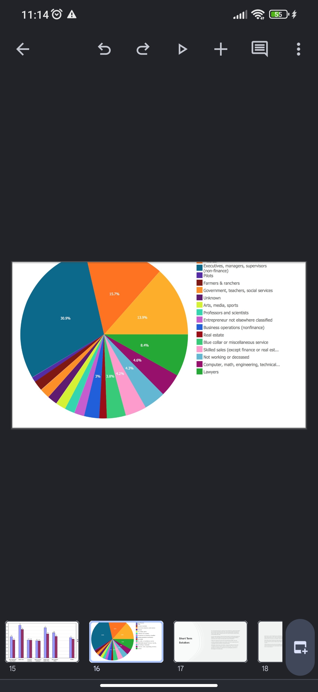
In this day and age, mobile phone usage is by and large a normal facet of modern life. The Internatonal Telecommunicaton Union (ITU) estmated that in 2015 there were more than 7 billion mobile cellular subscriptons worldwide.1 It is this near ubiquity that has made the mobile phone a target of much implementaton and research in relaton to improving rural development. Mobile phones have been shown (though not uniformly) to positvely contribute in various ways to rural development, from reducing informaton asymmetry, to improving functonal networks, to increasing access to services and fnance. Yet a digital gender divide exists. When contrasted with the fact that women compromise 43% of the worlds’ agricultural labor force,2 this digital gender divide can inhibit rural development. There is substantal exploraton of the digital gender divide in the literature. However, the answers to questons regarding diferental access and use of informaton and communicaton technologies are mostly inconclusive.

Slide 20
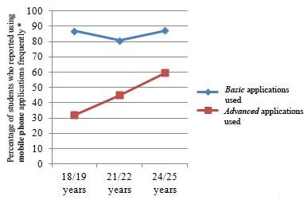
The usage of mobile phones by age groups upto 25 years

Slide 21
The decade growth of usage mobile phones from the year 1980 to and the upcoming year 2025

Slide 22
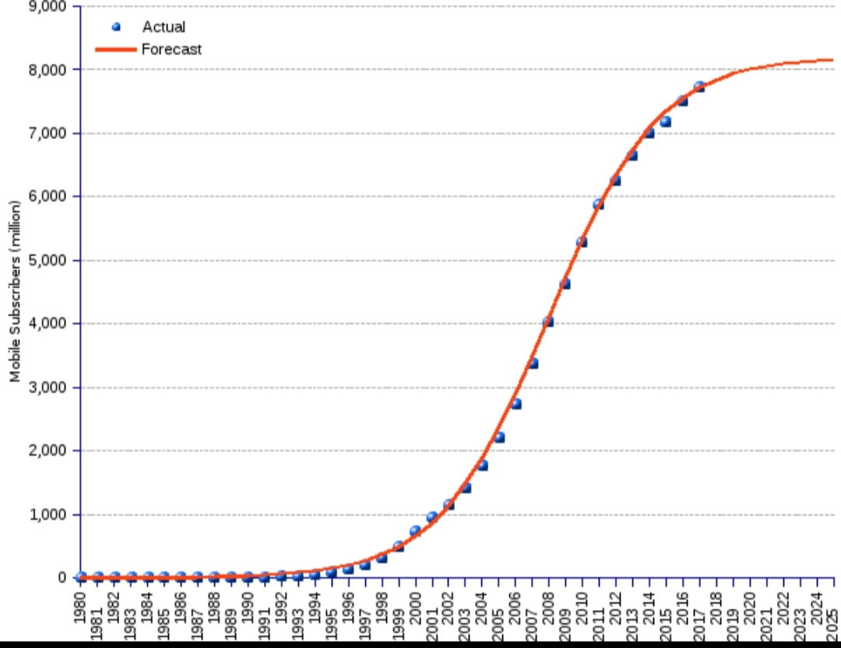

Slide 23
Short – Term Solutions

Slide 24
The rural economy, however, continues to be an informal one, largely cash-oriented with unstructured cash flows. Most of the rural working population is typically the “Earn and Pay” segment, largely excluded from formal employment opportunities and predictable cash flows.
They earn their livelihood in cash and therefore prefer to spend and discharge their liabilities in cash itself. Moreover, given the lack of adequate banking facilities in rural areas, cash continues to be the preferred mode of transaction.
Things are changing on the ground. Once predominantly agrarian, the rural economy is getting increasingly more diversified, with the non-agricultural sector contributing to about two-thirds of household incomes.
Additionally, those living in rural India are no longer as isolated from their urban counterparts as before, thanks to improved internet access. There is a whole generation of mobile-first rural Indians who have leapfrogged generations of technologies to the mobile phone.

Slide 25

Sometimes usage of mobile phones may cause to severe problems like addiction, viruses ,using mobile phones while batter is low it may causes to blasting of mobile phone and etc

Slide 26
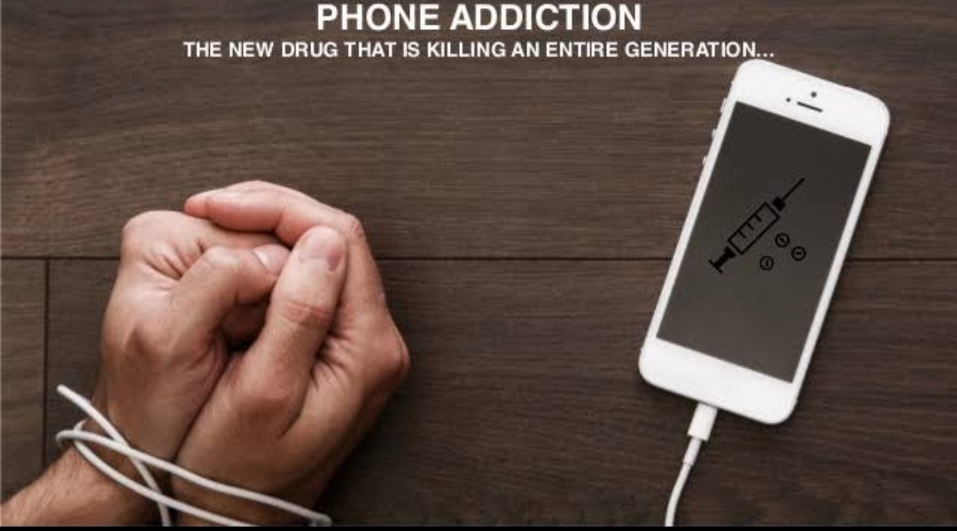
Most of the responses are female (50.25%) of age 18–25 (48.44%). However, respondents have used mobile phones for managing menstrual cycles and chronic/lifestyle diseases. Moreover, the degree of awareness and familiarity about the term “mobile health” was found to be more among technical students and working staff (55.17%) than medical students and health professionals (44.82%). Statistical results also revealed that awareness about the use of mobile phone for health-related components was found to be significant except for health awareness and education, and medication adherence and refilling. Further, about mobile health applications use, there exists a significant association between the study groups for the self-management applications of cancer, cholesterol, heart diseases, and stroke.

Slide 27
LONG TERM SOLUTIONS:

Slide 28
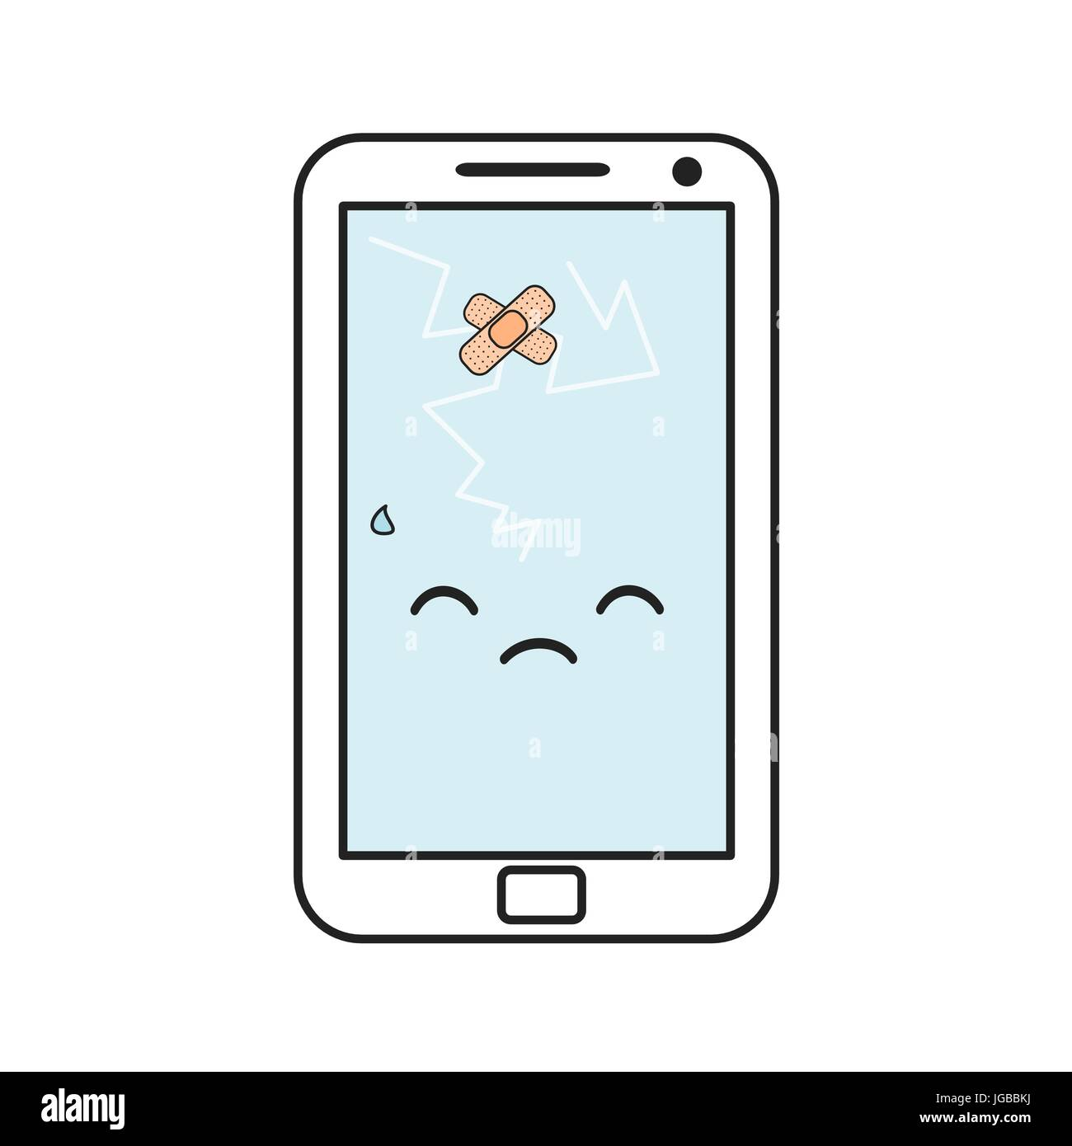
There are many long term solutions for usage of mobile phones . But using of mobile phones is not much better to use . And some of them are we are discussing and they are:

Slide 29
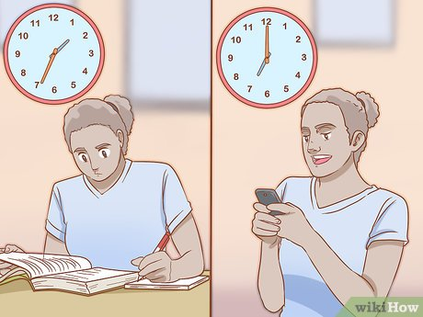
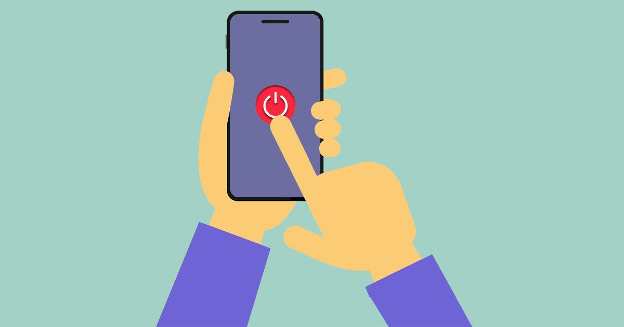

Don't use your phone as an alarm clock. Resist the urge to check your phone and social media immediately upon waking
Set limits for usage
Turn your phone off
Practice mindfulness.
Seek assistances

Slide 30
DIGITAL E-LEARNING

Slide 31
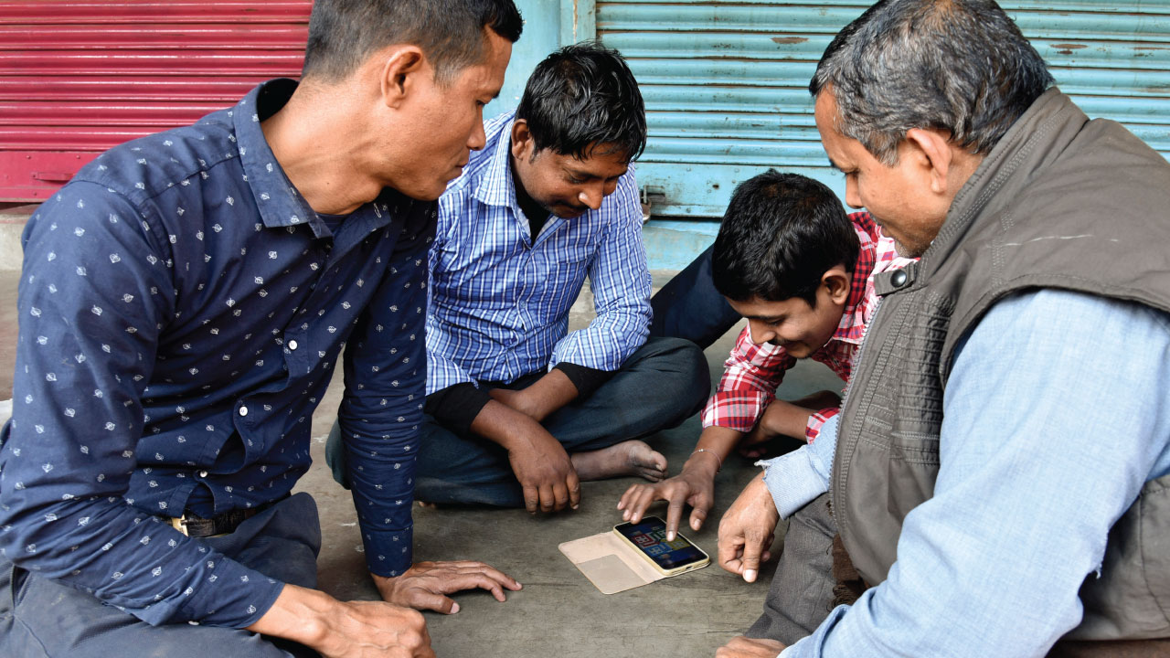
Some awareness pictures about usage mobile phones in rural areas

Slide 32
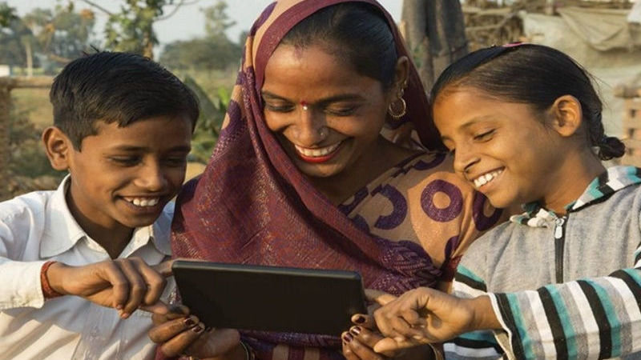
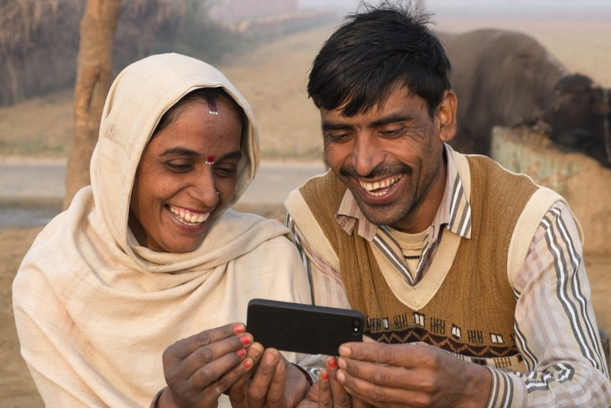

Slide 33



Slide 34


